Slide 1
MSDS451 TERM Project Fund management
Blade Robelly

Slide 2

General Investment Philosophy
Rejects the Efficient Market Hypothesis (Malkiel 2023)
Adopts Adaptive Markets and behavioral economics (Lo 2019)
Leverages data science, technical analysis, and financial engineering

Slide 3

Investment Methods
- Strategies employed:
• Buy-and-Hold
• Momentum
• Mean Reversion
• Hybrid (Momentum + Mean Reversion)
- Monte Carlo simulations to test robustness

Slide 4




Securities in the Fund
- Initial holdings (2015–2025):
• NVDA
• META
• MSFT
• AMZN
- Benchmark: S&P 500 (SPY)
- Rebalancing through strategy rules

Slide 5
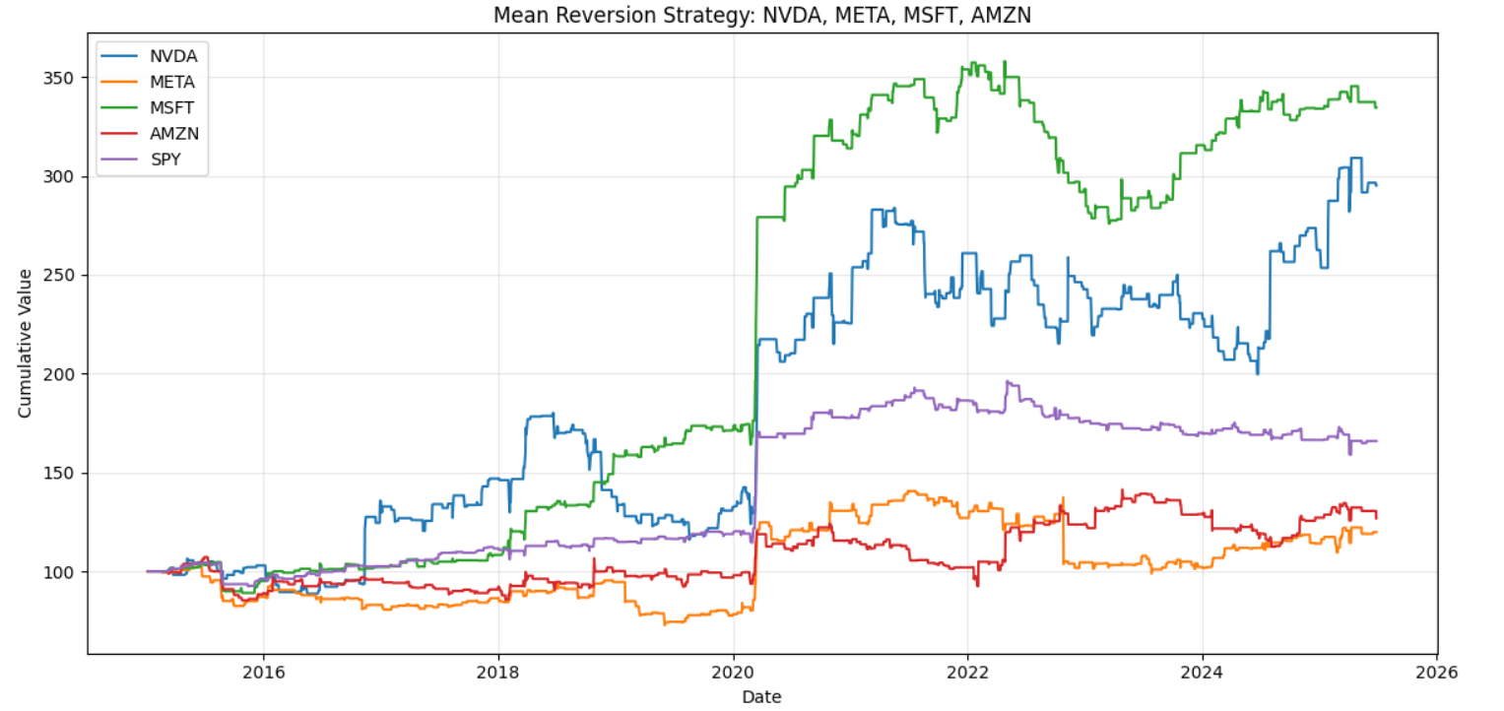

Slide 6
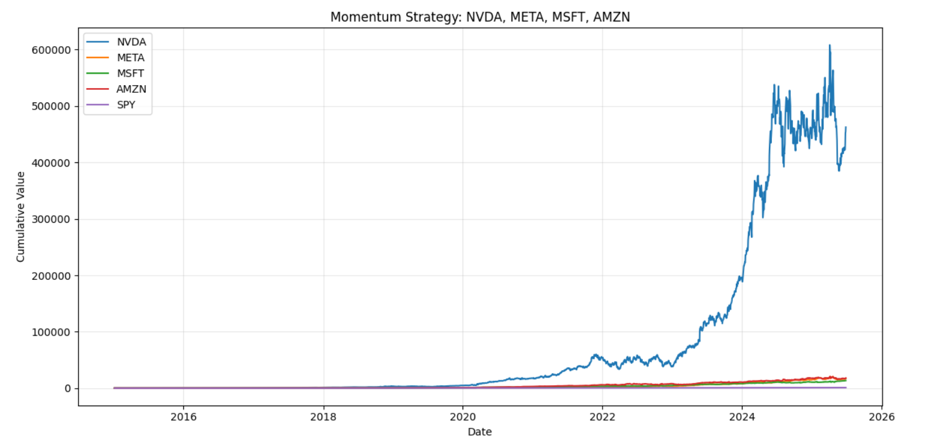

Slide 7
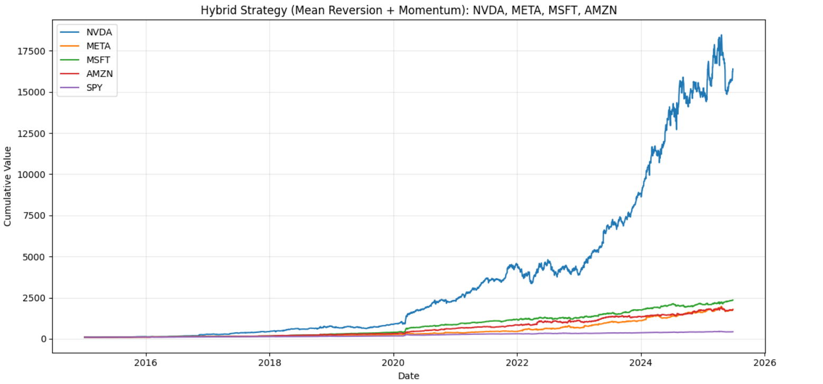

Slide 8
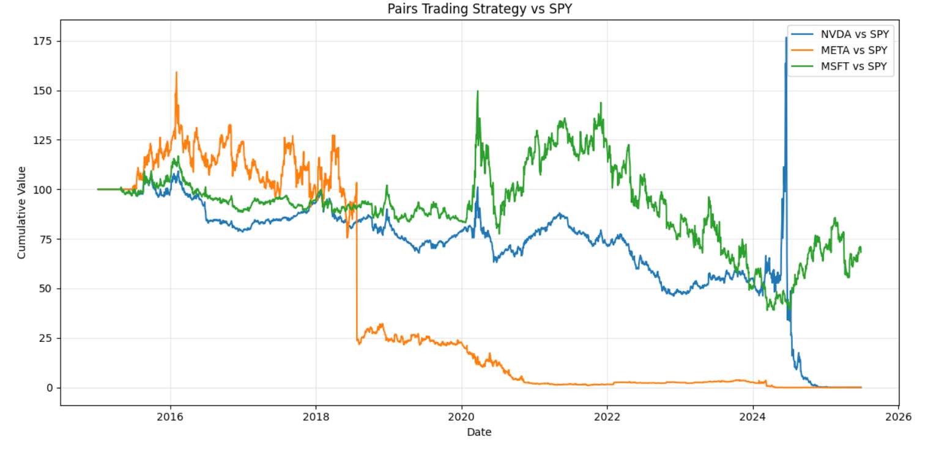

Slide 9
Performance Evaluation
- Historical Results (2015–2025):
• Sharpe Ratio: 1.04
• Alpha: 0.0015
• Beta: 1.36
• ROI: 3.4%
• Max Drawdown: < 1%
- Monte Carlo confirms robustness across simulations

Slide 10
Fee Modeling & Business Insight
Fee Structures Tested: 1–3% management, 10–25% performance
- Fund Viability:
• Break-even AUM: ~$3–5 million
• At $5M AUM, net profit ≈ $710K annually
• Higher AUM scales profitability substantially

Slide 11
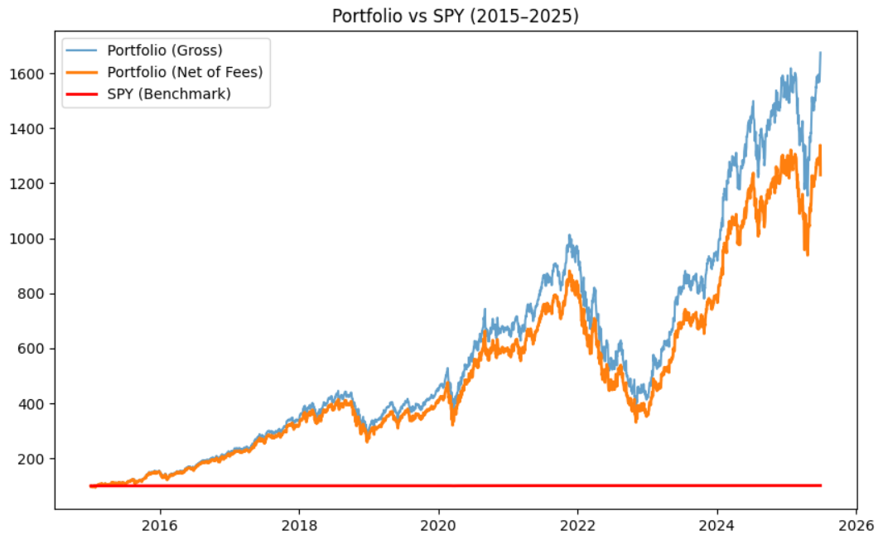

Slide 12
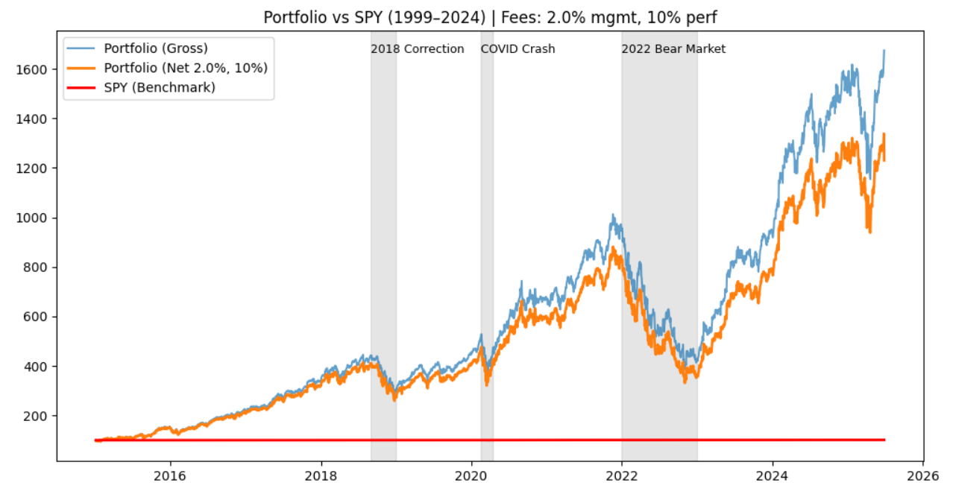
2015-2025

Slide 13
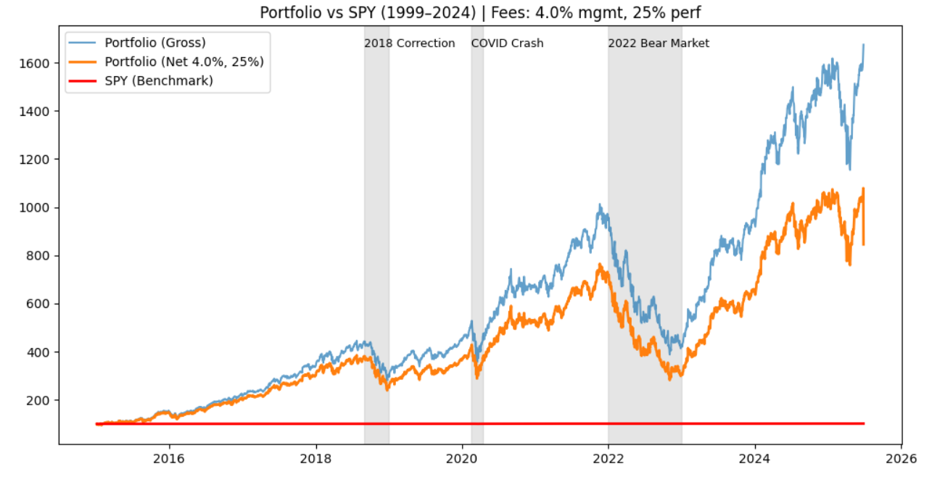
2015-2025

Slide 14
Management Recommendation
- Investor View: Viable with strong risk-adjusted returns
- Manager View: Profitable above $5M AUM
- Business Case: Attractive opportunity for both clients and managers
- Proposed Roles:
• Fund Manager
• Research Analyst
• CEO / Operations Lead

Slide 15

THANK YOU
Blade Robelly

